Slide 1
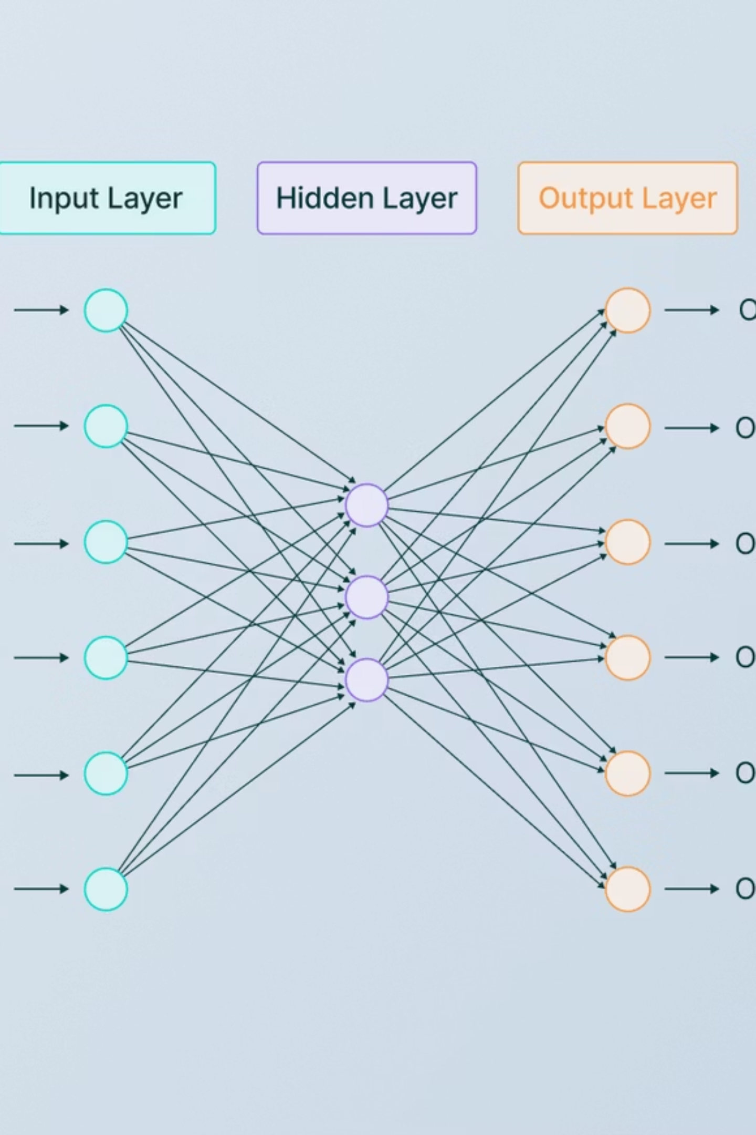
Automated CAPTCHA Recognition using CRNN + CTC Loss
Supervised Learning Project | TensorFlow Implementation
Course: Machine Learning & Deep Learning | December 2025

Slide 2
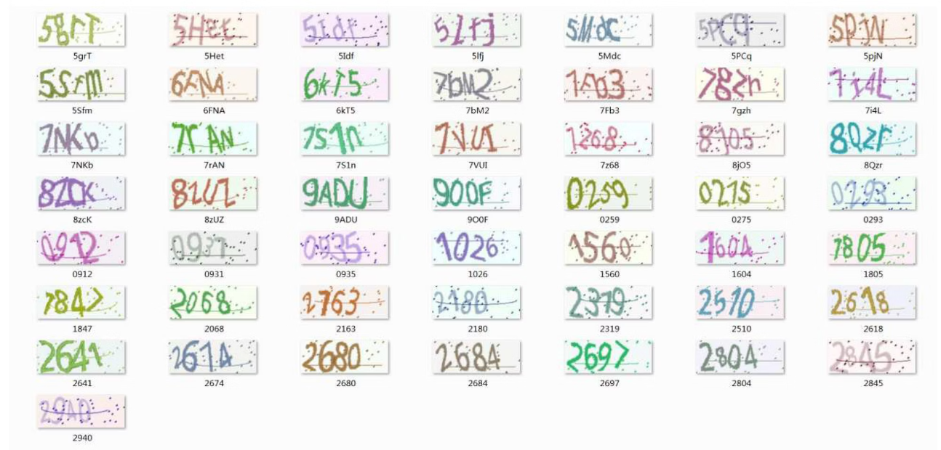
Problem Statement
CAPTCHAs are designed to prevent automated bot access, but modern machine learning techniques can effectively break simple image-based implementations. Our challenge is to develop an automated system that accurately recognizes distorted text sequences.
Dataset: Kaggle CAPTCHA dataset containing approximately 10,000 images with variable-length sequences (maximum 5 characters) drawn from a character set of 30+ alphanumeric symbols.

Slide 3
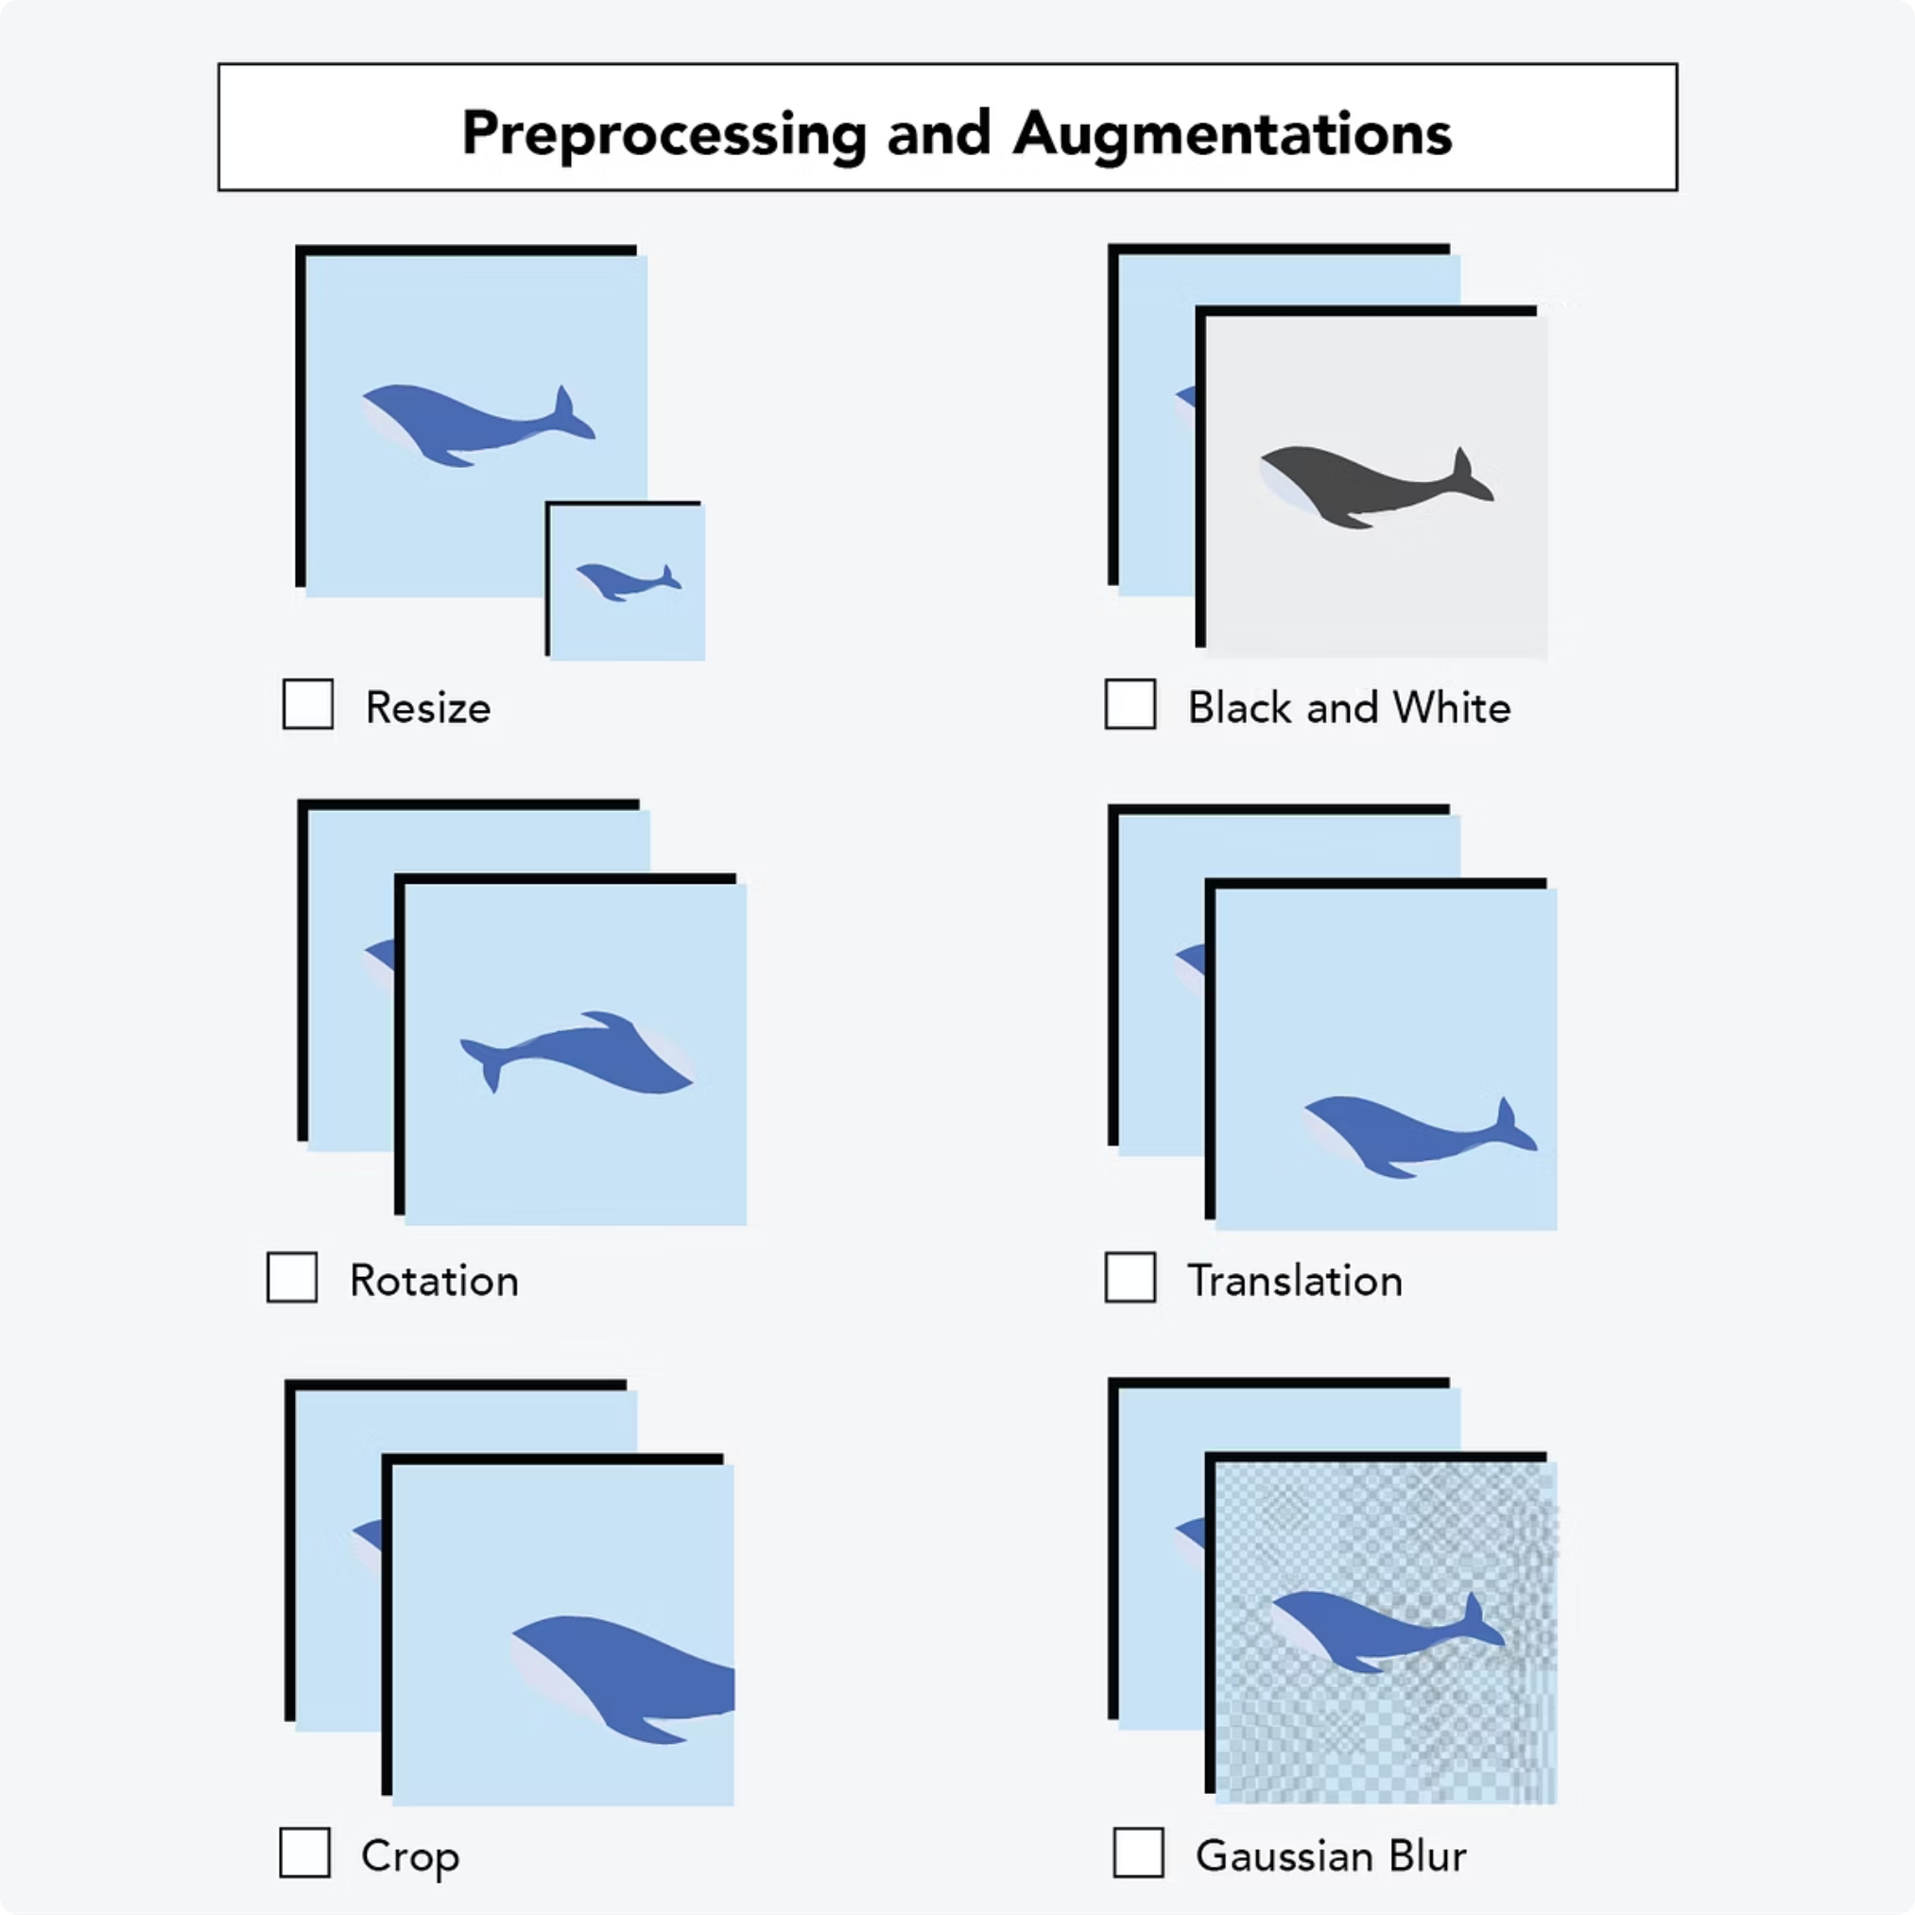
Dataset & Preprocessing Pipeline
01
02
Image Processing
Label Extraction
JPG format images resized to standardized 200×50 pixel dimensions, converted to grayscale, and normalized from [0-255] to [0-1] range for optimal neural network training.
Ground truth labels extracted directly from image filenames, validated for consistency, and mapped to numerical indices (e.g., character 'A' mapped to index 0).
03
Train-Validation Split
Dataset divided into 90% training set (with 50% subsampling for computational efficiency) and 10% validation set to monitor generalization performance.

Slide 4
Data Pipeline Architecture
Custom DataGenerator Implementation
def __getitem__(self, index): batch_indices = self.indices[ index * self.batch_size: (index + 1) * self.batch_size ] X, y = self.__data_generation( batch_indices ) return X, y
Built using keras.utils.Sequence for memory-efficient, batched data loading with automatic shuffling. Handles variable-length CAPTCHA sequences up to 5 characters seamlessly.
Generator Outputs:
Image tensors: (200×50×1) grayscale arrays
One-hot encoded labels with padding
Sequence length metadata for CTC alignment

Slide 5
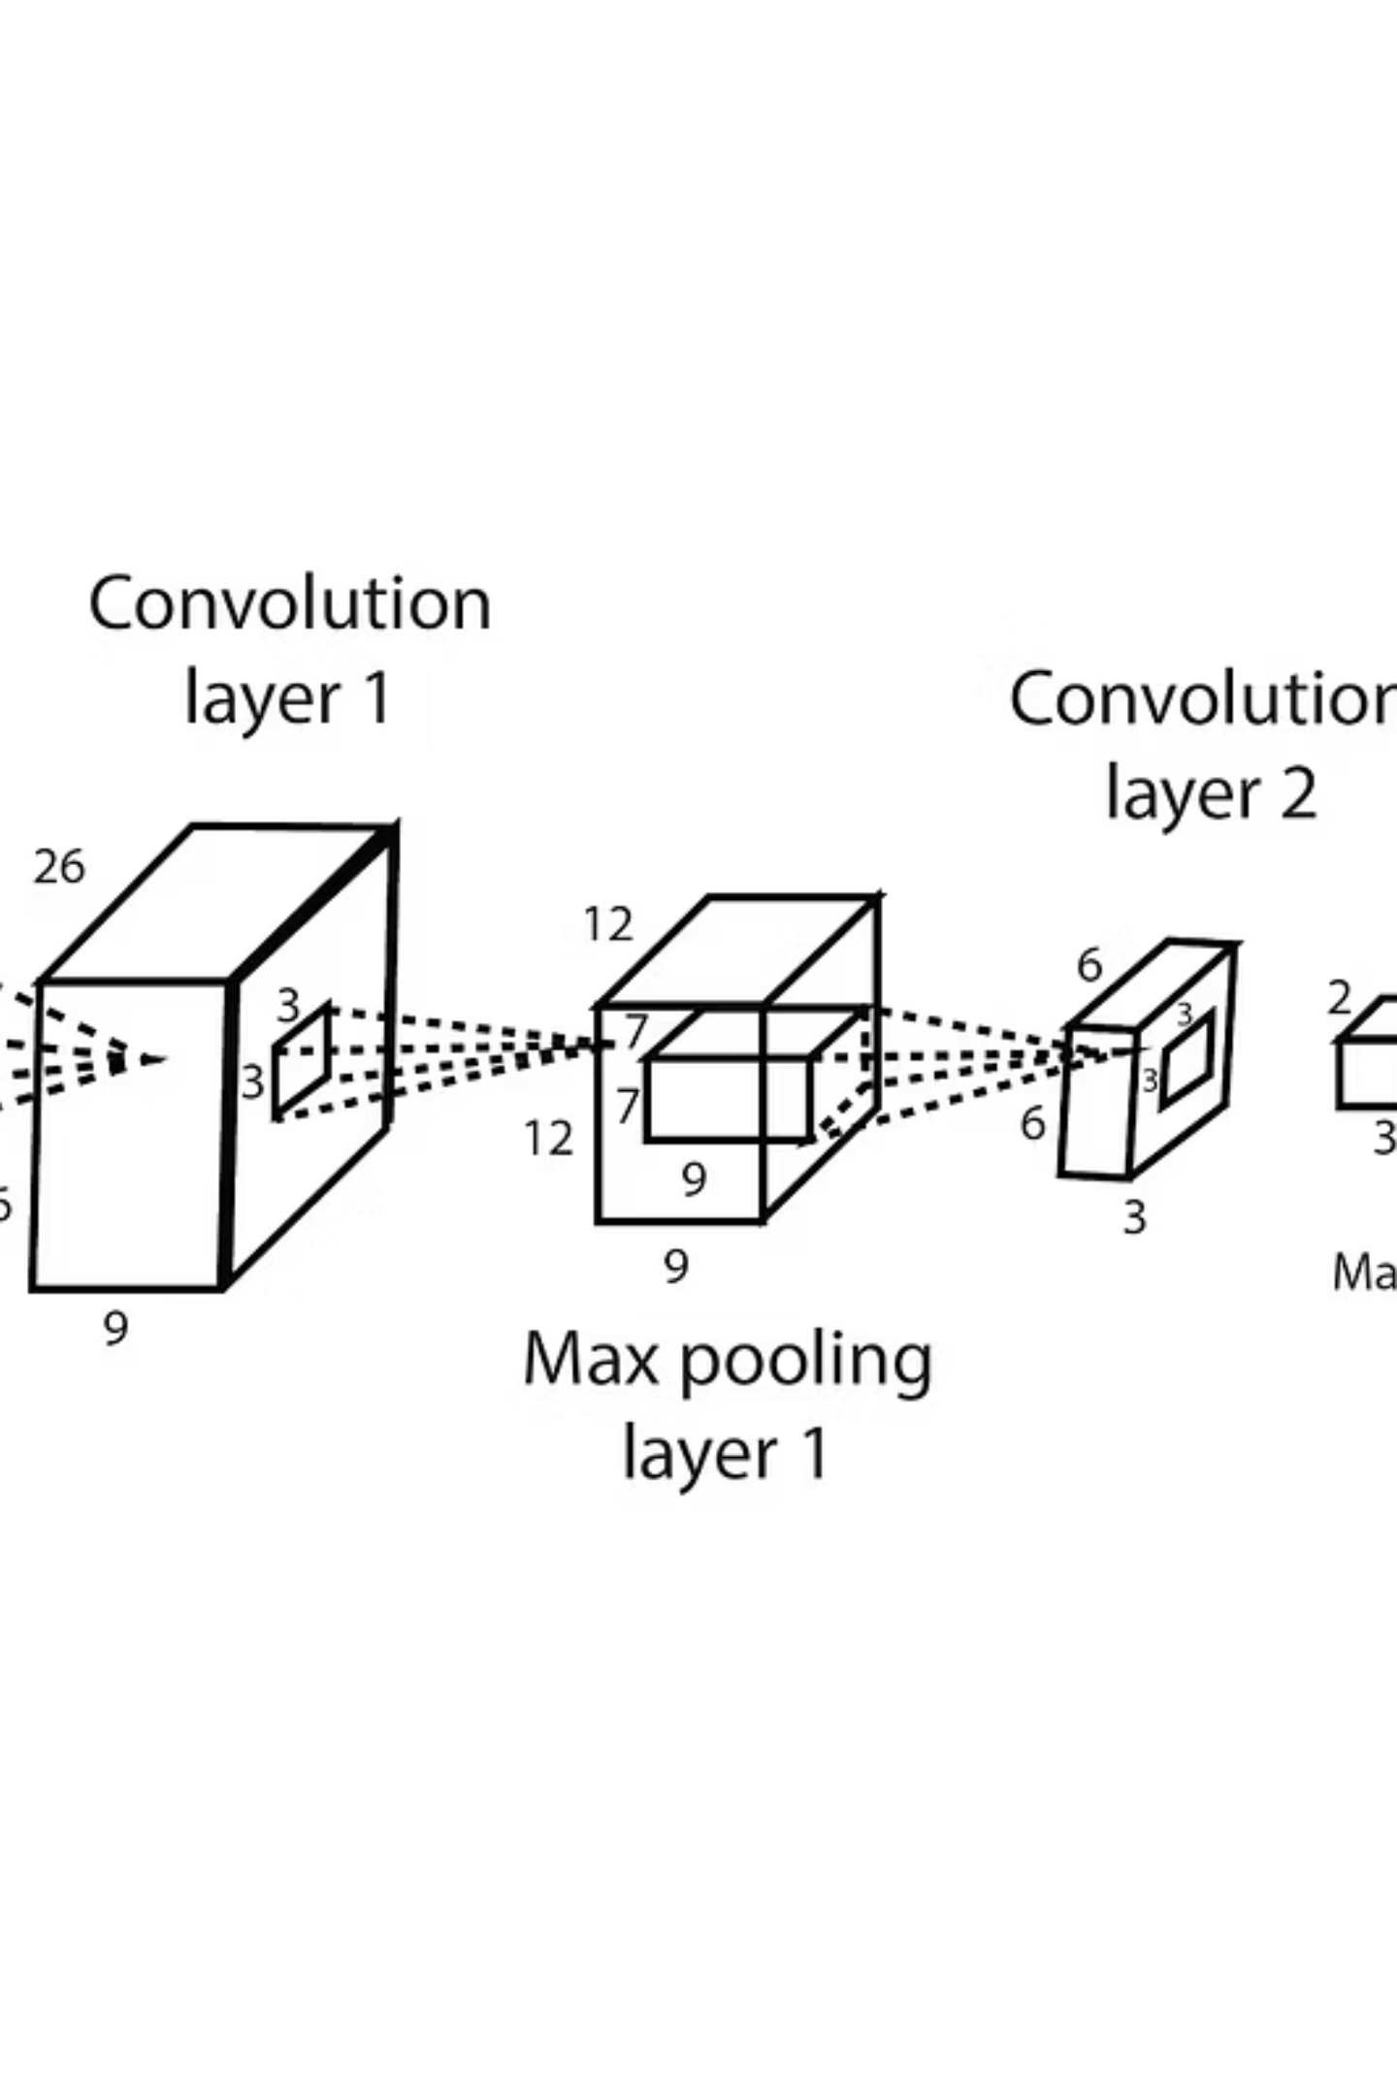
CRNN Model Architecture
CNN Backbone
Recurrent Layer
Two convolutional blocks with 32 and 64 filters respectively, followed by MaxPooling layers that downsample spatial dimensions by factor of 4.
Bidirectional LSTM with 128→64 units, return_sequences enabled, and dropout rates of 0.2-0.25 for regularization and overfitting prevention.
CTC Output
Dense softmax layer with (num_chars+1) outputs feeding into CTC Loss layer for alignment-free sequence prediction.

Slide 6
Training Configuration & Hyperparameters
Optimizer Comparison Study
optimizer = SGD( learning_rate=0.002, momentum=0.9, clipnorm=5.0)model.compile( optimizer=optimizer, loss=ctc_loss)
We evaluated three optimization algorithms to identify the most effective training strategy:
SGD: Learning rate 0.002, momentum 0.9, gradient clipping (clipnorm=5)
Adam: Adaptive learning with default parameters
RMSprop: Moving average gradient descent
Training Setup: Batch size 32, maximum 30 epochs, EarlyStopping with patience=5 to prevent overfitting.
CTC Loss eliminates need for character-level alignment supervision by handling variable-length sequence mapping automatically.

Slide 7
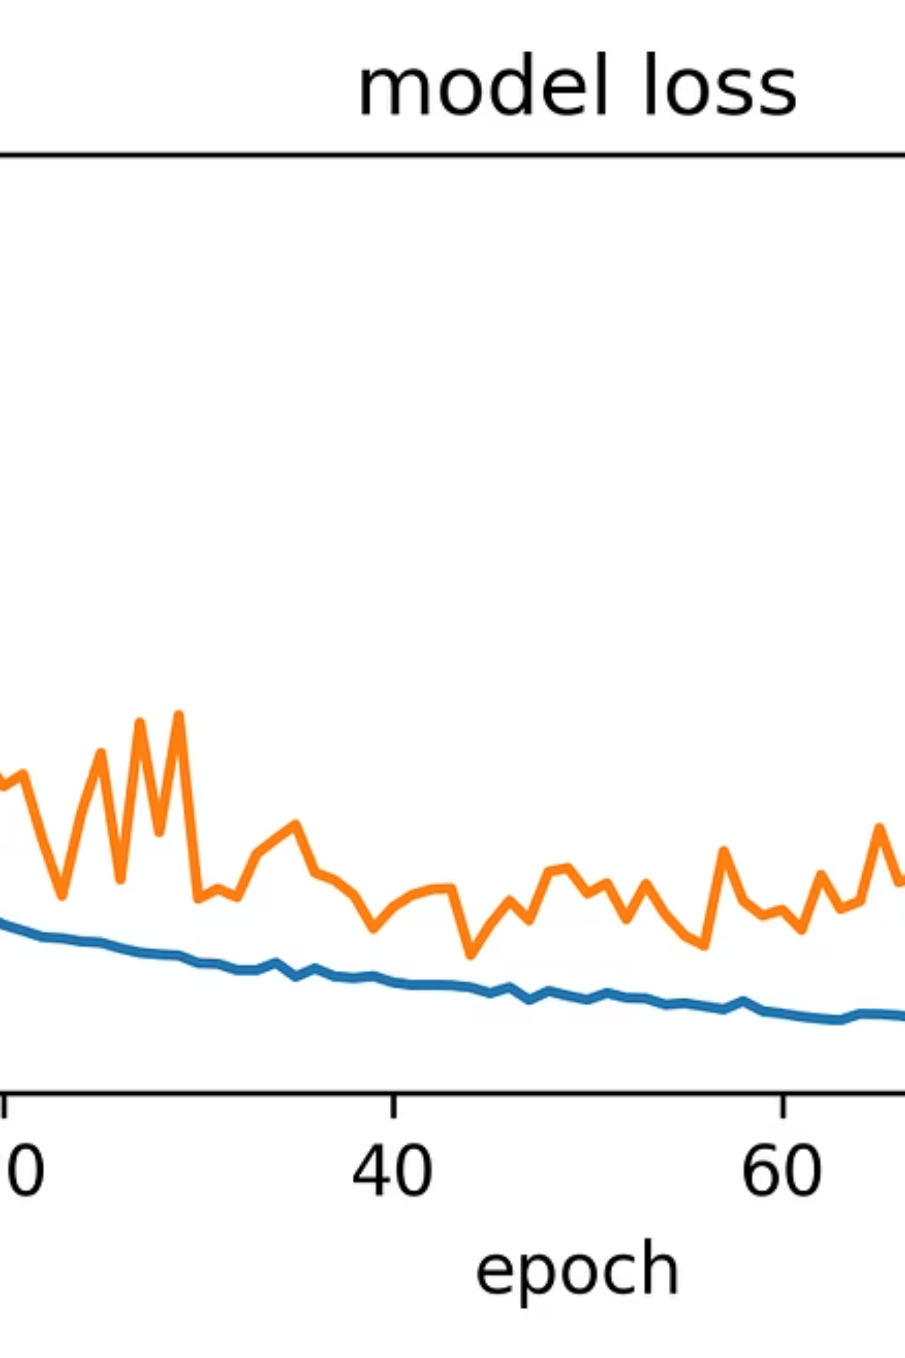
Training Performance Analysis
Training and validation loss curves demonstrate convergence behavior across different optimizers. All three approaches show steady improvement, with validation loss stabilizing around epochs 20-25, indicating successful model learning without significant overfitting.
Key Observation: Adam optimizer achieved fastest convergence while maintaining competitive final validation loss, making it the preferred choice for this sequence recognition task.

Slide 8
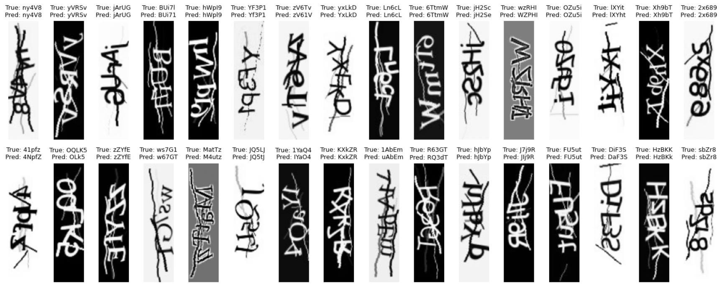
SGD Training Results - Full Epoch Breakdown
Summary
Total epochs completed: 30/30
Final training loss: 170.4224
Final validation loss: 145.5834
Total training time: ~4,500 seconds (75 minutes)
Key Milestones
Epoch 1: loss 693.3055 → val_loss 668.5797
Epoch 5: loss 539.9130 → val_loss 502.3946
Epoch 10: loss 376.4460 → val_loss 342.1677
Epoch 15: loss 287.4702 → val_loss 253.9253
Epoch 20: loss 231.7423 → val_loss 199.6609
Epoch 25: loss 197.7676 → val_loss 169.8297
Epoch 30: loss 170.4224 → val_loss 145.5834
Observations
Steady convergence across all 30 epochs
Consistent loss reduction with no plateauing
Validation loss stabilization after epoch 20
No signs of overfitting (training and validation losses track closely)

Slide 9
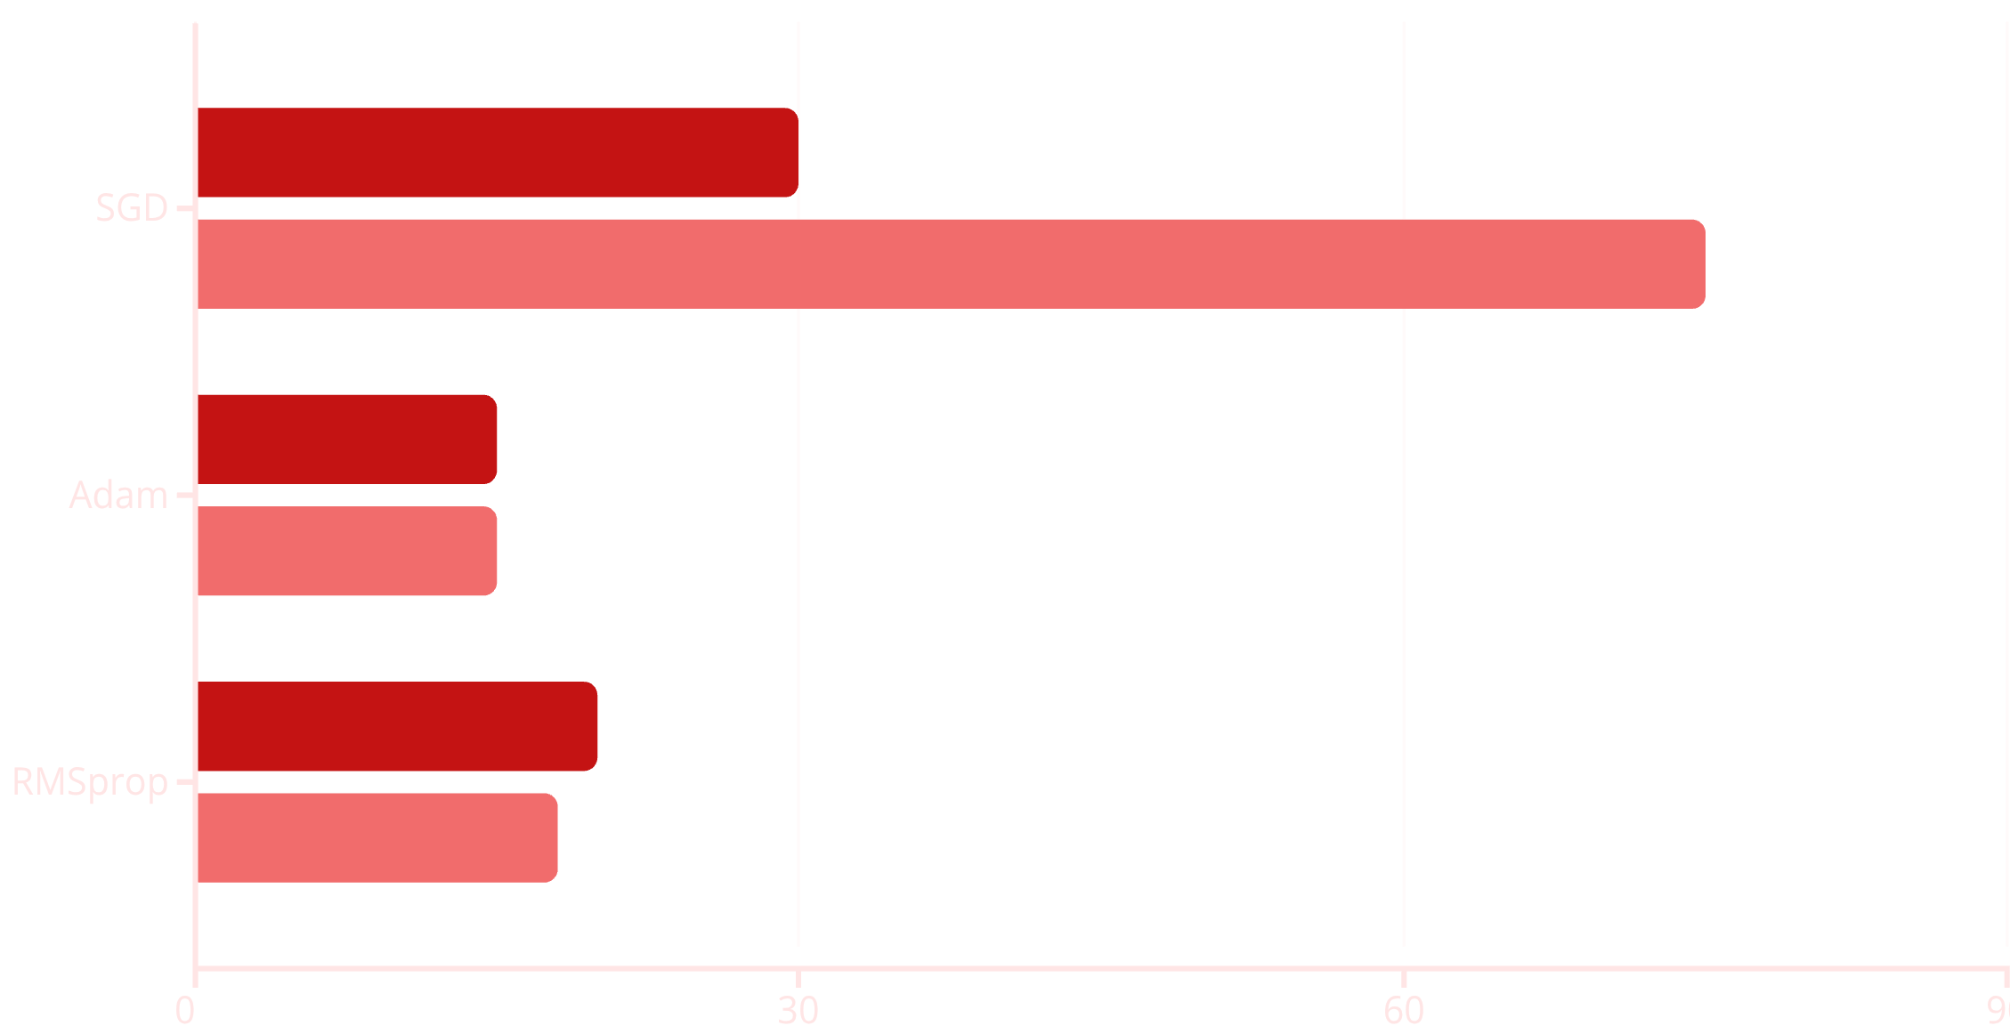

Optimizer Comparison Results
Convergence Epochs
Training Time (minutes)
Adam: Best Overall
SGD: Full Training Completion
RMSprop: Middle Ground
Fastest convergence in just 15 epochs with competitive accuracy, optimal balance of speed and performance for CAPTCHA recognition tasks.
Achieved convergence across all 30 epochs with steady loss reduction, requiring 75 minutes total training time. Demonstrates reliable performance with momentum and gradient clipping despite longer training duration.
Moderate convergence speed and training time, adaptive learning rate provides consistent intermediate-level performance.

Slide 10


Model Inference & Limitations
Prediction Pipeline
Current Limitations
CTC decode algorithm converts model outputs into predicted character sequences. The system processes input images through the trained CRNN and generates text predictions with high accuracy on clean samples.
Heavy Distortion: Model struggles with extreme visual noise or complex background patterns
Dataset Size: Training on 50% subsampled data limits maximum achievable accuracy
Character Set: Performance degrades on rare character combinations not well-represented in training set
These limitations present clear opportunities for future model refinement and enhanced data preprocessing strategies.

Slide 11
Conclusion & Future Directions
Key Achievements
Critical Learnings
Future Enhancement Roadmap
Successfully implemented end-to-end CAPTCHA recognition system using CRNN architecture with CTC Loss
CTC Loss provides elegant solution for sequence-to-sequence problems without requiring character-level alignment annotations. Custom data generators enable efficient handling of large-scale image datasets within memory constraints.
Train on complete dataset without subsampling to maximize accuracy potential
Comprehensive optimizer comparison revealed Adam as optimal choice for sequence recognition tasks
Implement data augmentation (rotation, scaling, noise injection) for improved robustness
Demonstrated viability of alignment-free training approach for variable-length text sequences
Deploy as REST API for real-time CAPTCHA recognition applications

